Slide 1


Restaurants Performance Review
Insights and Opportunities
Prepared By Rashmi Balasada
26th Jan ‘2025
Data As on Jan’ 2020 to Dec’ 2024

Slide 2
Performance Review: Key Metrics
02
Performance Review: Trends and Analysis
01
A snapshot of essential business metrics, including revenue, orders, and customer ratings, to evaluate performance.
Analyzing trends in revenue and customer behavior to identify growth opportunities and areas of improvement.
Contents
Revenue Distribution Analysis
04
Key Insights and Strategic Recommendations:
03
Examining revenue distribution across locations, cuisines, and restaurants to identify key growth drivers.
Offering actionable insights and strategic recommendations to enhance operations and drive future growth.

Slide 3





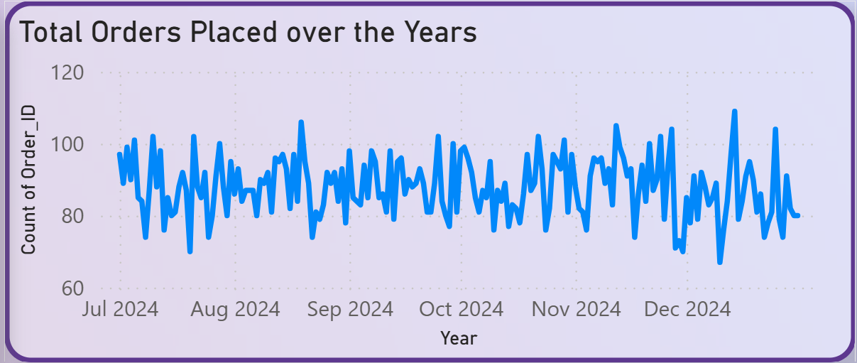
Performance Review: Key Metrics
Total Revenue
Orders Served
Total Profits
Customer Rating
Max Order Value
197M
160.07K
118M
9.51
4320
The business shows strong performance with 197M in revenue and 118M in profit, backed by 160.07K orders and a 9.51 customer rating. A solid employee base of 391 supports operations, while a max order value of 4320 indicates catering to premium customers. Overall, the company is efficiently balancing growth, profitability, and customer satisfaction.

Slide 4


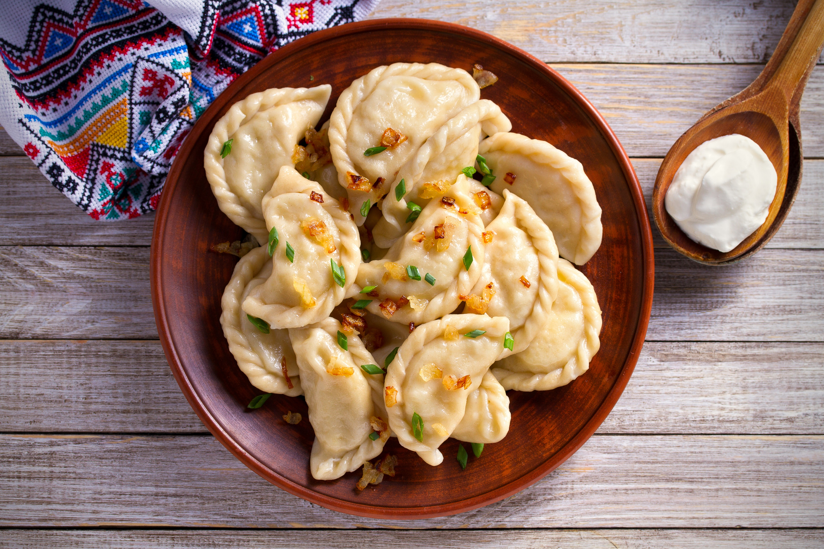
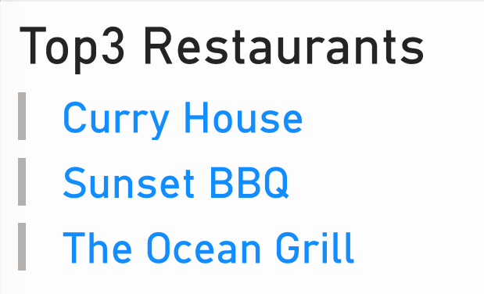
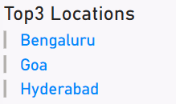
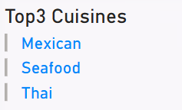
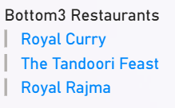
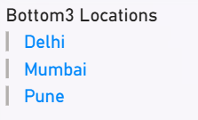
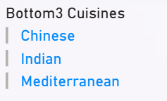
Performance Review: Trends and Analysis

Slide 5
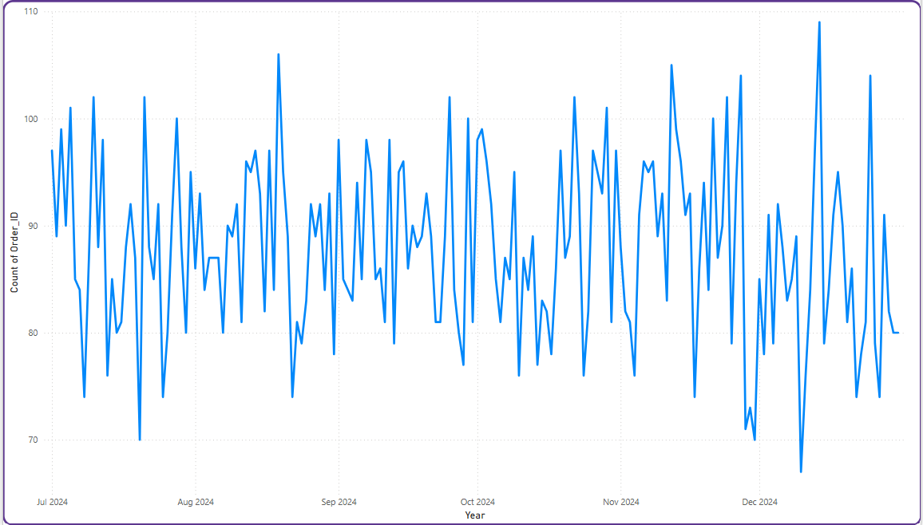
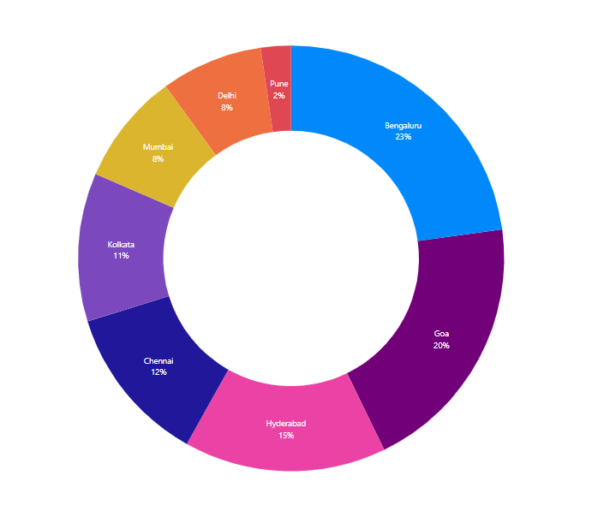
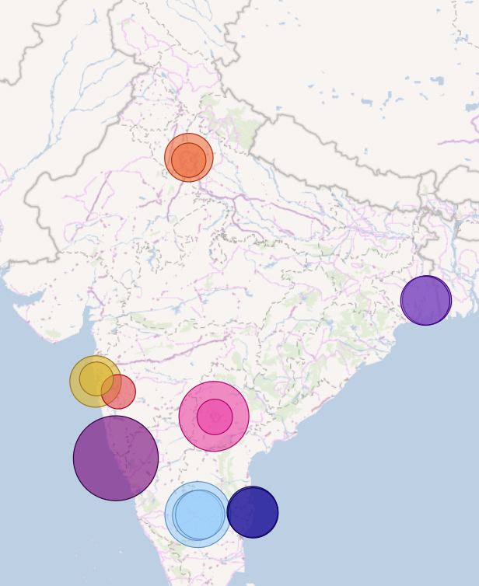
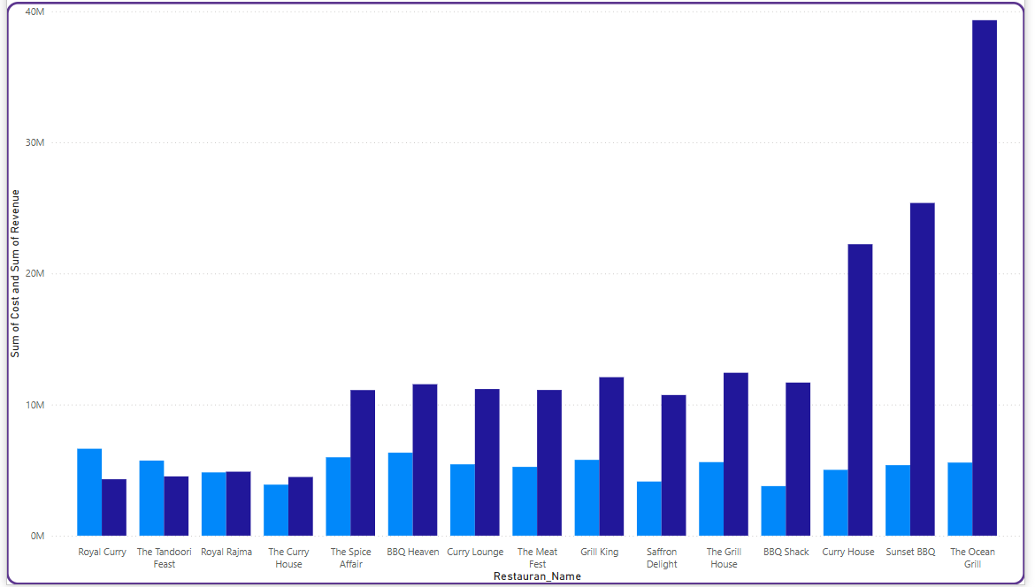
Revenue Distribution Analysis
Performance Review: Key Metrics
The data highlights strong revenue and profit performance in locations like Goa and Hyderabad, with key drivers being efficient cost management and popular cuisines. However, restaurants like Royal Curry and The Tandoori Feast face challenges due to high operational costs, requiring targeted improvements for profitability.
Total Orders Placed over Time
% Revenue by Location
Revenue Bubbles
Total Cost Vs Revenue by Restaurant Name

Slide 6




Key Insights and
Strategic Recommendations:
Restaurants like Curry Lounge and BBQ Shack show strong profitability, indicating effective cost control and customer demand. These restaurants should continue to optimize operational efficiency and explore opportunities to increase capacity or expand offerings.
Restaurants with higher ratings, such as The Grill House and The Spice Affair, maintain strong customer loyalty. Focusing on improving the customer experience through personalized services or loyalty programs could further enhance repeat business.
High-performing locations such as Goa and Hyderabad contribute significantly to overall revenue. Expanding the presence in these high-demand areas or replicating the successful location models elsewhere can boost revenue further.
Indian and BBQ cuisines are consistently linked to high revenues, suggesting strong customer preferences. Further investment in these popular cuisines or introducing exclusive regional variations could help increase customer engagement.
High-performing locations such as Goa and Hyderabad contribute significantly to overall revenue. Expanding the presence in these high-demand areas or replicating the successful location models elsewhere can boost revenue further.

